Slide 1
Contrast Enhancement

Slide 2
Contrast enhancement is a digital image processing technique used to improve the visibility of details in an image by increasing the difference between the pixel intensities. The goal of contrast enhancement is to make the image visually more appealing and easier for human perception.
In digital images, the pixel intensity represents the brightness or color of each pixel.
Low contrast images have a limited range of intensity values, resulting in a flat and dull appearance.
Conversely, high contrast images have a wide range of intensity values, leading to a more vibrant and distinct appearance.

Slide 3
various methods for contrast enhancement
Histogram Equalization
Adaptive Contrast Enhancement
Histogram Specification
Enhancement using Image Processing Filters:

Slide 4
Histogram Equalization
Histogram equalization is a popular contrast enhancement technique used in digital image processing to improve the visibility of details in an image by spreading out the intensity values across a wider range.
The primary goal of histogram equalization is to obtain a uniform histogram, which results in a higher contrast image with enhanced brightness and detail.

Slide 5
histogram equalization Algorithm
Find the frequency of each value represented on the horizontal axis of the histogram i.e. intensity in the case of an image.
Calculate the probability density function for each intensity value.
After finding the PDF, calculate the cumulative density function for each intensity’s frequency.
The CDF value is in the range 0-1, so we multiply all CDF values by the largest value of intensity i.e. 255.
Round off the final values to integer values.

Slide 6
Numerical Example
Consider a 3-bit image of size 4×5 as shown below:
0 | 1 | 1 | 3 | 4
7 | 2 | 5 | 5 | 7
6 | 3 | 2 | 1 | 1
1 | 4 | 4 | 2 | 1

Slide 7
Step 1:
Find the range of intensity values.
[0, 1, 2, 3, 4, 5, 6, 7]

Slide 8
Step 2:
Find the frequency of each intensity value.
[1, 6, 3, 2, 3, 2, 1, 2]

Slide 9
Step 3: Calculate the probability density function for each frequency.
total = 20 = 4*5
Calculate PDF = frequency of each intensity/Total sum of all frequencies, for each i value of intensity
For intensity 0, frequency is 1.
PDF=1/20=0.05
For intensity 1, frequency is 6.
PDF=6/20=0.3

Slide 10
Step 4
Calculate CDF =cumulative frequency of each intensity value = sum of all PDF value (<=i)

Slide 11
Step 5
Multiply CDF with 7.
Why 7?
Because we have 3 bit image.
So, range of intensity values is 0 to 7.
Multiplication factor is maximum value of intensity.

Slide 12
Step 6
Round off the final value of intensity.

Slide 13
Solution
Range | Frequency | PDF | CDF | 7*CDF | Round-off
0 | 1 | 0.0500 | 0.0500 | 0.3500 | 0
1 | 6 | 0.3000 | 0.3500 | 2.4500 | 2
2 | 3 | 0.1500 | 0.5000 | 3.5000 | 4
3 | 2 | 0.1000 | 0.6000 | 4.2000 | 4
4 | 3 | 0.1500 | 0.7500 | 5.2500 | 5
5 | 2 | 0.1000 | 0.8500 | 5.9500 | 6
6 | 1 | 0.0500 | 0.9000 | 6.3000 | 6
7 | 2 | 0.1000 | 1.0000 | 7.0000 | 7

Slide 14
Output
0 | 1 | 1 | 3 | 4
7 | 2 | 5 | 5 | 7
6 | 3 | 2 | 1 | 1
1 | 4 | 4 | 2 | 1
0 | 2 | 2 | 4 | 5
7 | 4 | 6 | 6 | 7
6 | 4 | 4 | 2 | 2
2 | 5 | 5 | 4 | 2
Old Image
New Image

Slide 15
Example 2
Consider a 3 bit image:
[[3, 2, 6, 5, 0],
[1, 4, 7, 3, 2],
[0, 5, 1, 6, 4],
[7, 3, 2, 1, 0]]
Calculate histogram of the image.
Analyze the histogram.
Perform histogram equalization.

Slide 16
Program for histogram equalization
# import Opencv
import cv2
# import Numpy
import numpy as np
# read a image using imread
img = cv2.imread(\'F:\\do_nawab.png\', 0)
# creating a Histograms Equalization
# of a image using cv2.equalizeHist()
equ = cv2.equalizeHist(img)
# stacking images side-by-side
res = np.hstack((img, equ))
# show image input vs output
cv2.imshow(\'image\', res)
cv2.waitKey(0)
cv2.destroyAllWindows()

Slide 17
Adaptive Contrast Enhancement
Adaptive contrast enhancement is a variation of contrast enhancement techniques that aims to improve the visibility and quality of an image by adjusting the contrast locally based on the characteristics of the image content.
In this approach, the contrast enhancement is applied differently to different regions of the image, depending on factors such as local intensity variations, gradients, and other image properties.
One common method for adaptive contrast enhancement is the adaptive histogram equalization, particularly the "Contrast Limited Adaptive Histogram Equalization" (CLAHE) algorithm. CLAHE prevents over-amplification of noise in flat regions by limiting the contrast amplification for each local region.
The general steps for performing Adaptive Histogram Equalization (CLAHE) are as follows:
Divide the image into small overlapping tiles or regions.
Apply histogram equalization to each of these regions independently.
Limit the contrast amplification in each region to prevent excessive enhancement.

Slide 18
Program for Adaptive histogram equalization
import cv2
import numpy as np
# Reading the image from the present directory
image = cv2.imread("image.jpg")
# Resizing the image for compatibility
image = cv2.resize(image, (500, 600))
# The initial processing of the image
# image = cv2.medianBlur(image, 3)
image_bw = cv2.cvtColor(image, cv2.COLOR_BGR2GRAY)
# The declaration of CLAHE
# clipLimit -> Threshold for contrast limiting
clahe = cv2.createCLAHE(clipLimit=5)
final_img = clahe.apply(image_bw) + 30
# Ordinary thresholding the same image
_, ordinary_img = cv2.threshold(image_bw, 155, 255, cv2.THRESH_BINARY)
# Showing the two images
cv2.imshow("ordinary threshold", ordinary_img)
cv2.imshow("CLAHE image", final_img)

Slide 19
Histogram Specification (Matching)
Histogram specification, also known as histogram matching or histogram equalization with a specified target, is a technique used to transform the intensity values of an image so that its histogram matches the specified target histogram.
The main goal of histogram specification is to adjust the contrast and brightness of an image to match a desired histogram distribution.

Slide 20
Histogram Specification
Calculate the cumulative distribution function (CDF) of the input image's histogram.
Calculate the cumulative distribution function (CDF) of the target histogram.
Create a mapping function that maps each intensity level of the input image to the corresponding intensity level in the target histogram. This mapping function can be obtained by matching the CDFs of the input and target histograms.
Apply the mapping function to the input image to obtain the final output image with the desired histogram.

Slide 21
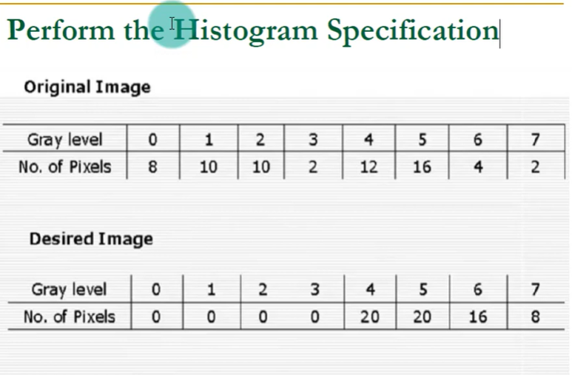

Slide 22
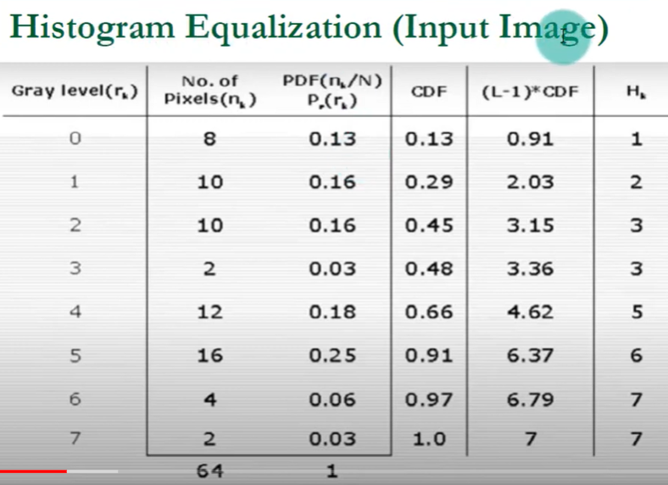

Slide 23
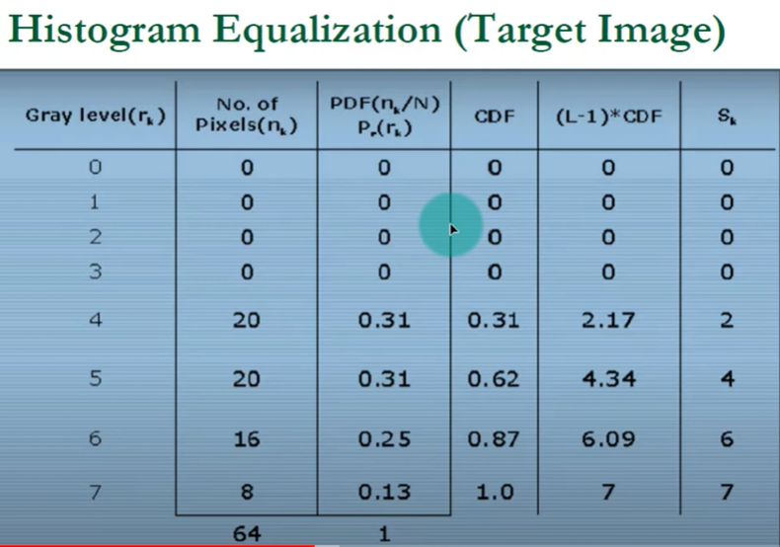

Slide 24
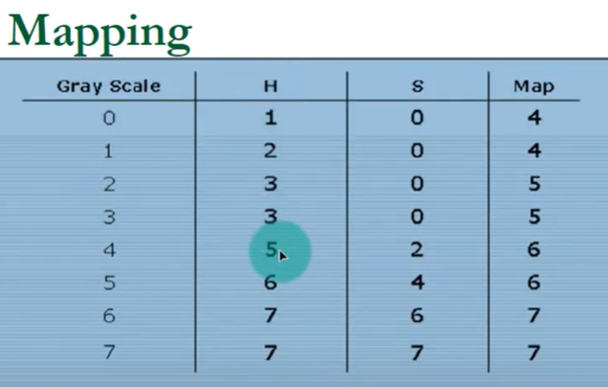
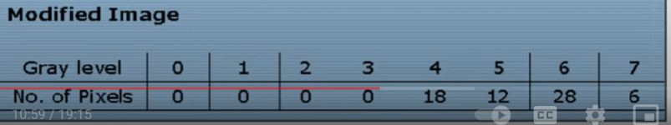

Slide 25

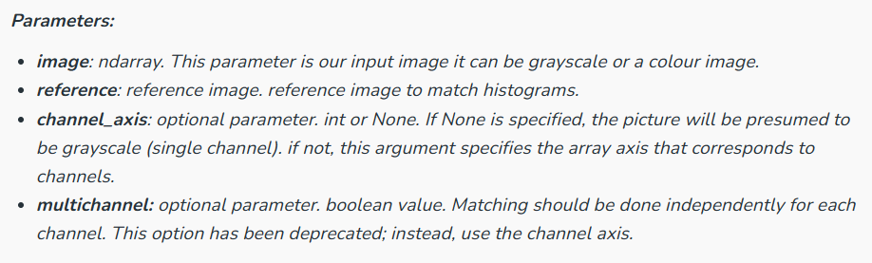
Program: Histogram Specification

Slide 26
# import packages
import matplotlib.pyplot as plt
from skimage import exposure
from skimage.exposure import match_histograms
import cv2
# reading main image
img1 = cv2.imread("img.jpeg")
# checking the number of channels
print('No of Channel is: ' + str(img1.ndim))
# reading reference image
img2 = cv2.imread("2Fw13.jpeg")
# checking the number of channels
print('No of Channel is: ' + str(img2.ndim))
image = img1
reference = img2
matched = match_histograms(image, reference ,
multichannel=True)
fig, (ax1, ax2, ax3) = plt.subplots(nrows=1, ncols=3,
figsize=(8, 3),
sharex=True, sharey=True)
for aa in (ax1, ax2, ax3):
aa.set_axis_off()
ax1.imshow(image)
ax1.set_title('Source')
ax2.imshow(reference)
ax2.set_title('Reference')
ax3.imshow(matched)
ax3.set_title('Matched')
plt.tight_layout()
plt.show()
fig, axes = plt.subplots(nrows=3, ncols=3, figsize=(8, 8))
for i, img in enumerate((image, reference, matched)):
for c, c_color in enumerate(('red', 'green', 'blue')):
img_hist, bins = exposure.histogram(img[..., c],
source_range='dtype')
axes[c, i].plot(bins, img_hist / img_hist.max())
img_cdf, bins = exposure.cumulative_distribution(img[..., c])
axes[c, i].plot(bins, img_cdf)
axes[c, 0].set_ylabel(c_color)
axes[0, 0].set_title('Source')
axes[0, 1].set_title('Reference')
axes[0, 2].set_title('Matched')
plt.tight_layout()
plt.show()

Slide 27
Contrast Stretching
Contrast stretching is a technique used in image processing to improve the contrast of an image.
The goal of contrast stretching is to enhance the visual appearance of an image by spreading out the intensity values over a broader range, thus increasing the difference between the darkest and brightest parts of the image.
This process makes the image visually more appealing and easier to interpret.

Slide 28
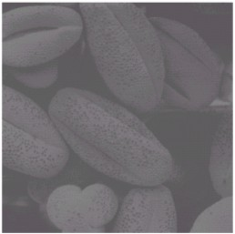
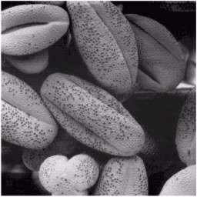
Contrast Strecthing
The main idea behind contrast stretching is to map the original pixel values to a new range of values using a simple linear transformation. The process involves two main steps:
Finding the minimum and maximum pixel values in the original image (min_val and max_val, respectively).
Applying the linear transformation to map the pixel values to a new range (e.g., 0 to 255 for an 8-bit image).

Slide 29
Numerical
Lets consider a 8 bit gray scale image representation:
Step 1: Find the minimum and maximum pixel values in the original image.
Minimum pixel value (min_val) = 30
Maximum pixel value (max_val) = 220
Step 2: Apply the linear transformation to stretch the pixel values to a new range (0 to 255).
Let's assume we want to set the new_min_val to 0 and new_max_val to 255.
new_pixel_value = (old_pixel_value - min_val) * (new_max_val - new_min_val) / (max_val - min_val) + new_min_val
30 | 50 | 80 | 100
120 | 150 | 200 | 220

Slide 30
Applying the formula to each pixel value in the original image:
new_pixel_value = (30 - 30) * (255 - 0) / (220 - 30) + 0 = 0
new_pixel_value = (50 - 30) * (255 - 0) / (220 - 30) + 0 = 9
new_pixel_value = (80 - 30) * (255 - 0) / (220 - 30) + 0 = 72
new_pixel_value = (100 - 30) * (255 - 0) / (220 - 30) + 0 = 111
new_pixel_value = (120 - 30) * (255 - 0) / (220 - 30) + 0 = 150
new_pixel_value = (150 - 30) * (255 - 0) / (220 - 30) + 0 = 208
new_pixel_value = (200 - 30) * (255 - 0) / (220 - 30) + 0 = 252
new_pixel_value = (220 - 30) * (255 - 0) / (220 - 30) + 0 = 255

Slide 31
New Image (After Contrast Stretching):
0 | 9 | 72 | 111
150 | 208 | 252 | 255

Slide 32
Program: Contrast Stretching
import cv2
import numpy as np
def contrast_stretching(image):
# Finding the minimum and maximum pixel values in the image
min_val = np.min(image)
max_val = np.max(image)
# Define the new range for pixel values (0 to 255)
new_min_val = 0
new_max_val = 255
# Linear transformation to stretch the pixel values
stretched_image = ((image - min_val) * (new_max_val - new_min_val) / (max_val - min_val)).astype(np.uint8)
return stretched_image
# Replace 'image_path' with the path to your image file
image_path = 'path/to/your/image.jpg'
# Read the image using OpenCV
original_image = cv2.imread(image_path, cv2.IMREAD_GRAYSCALE)
# Apply contrast stretching
stretched_image = contrast_stretching(original_image)
# Display the original and contrast-stretched images
cv2.imshow('Original Image', original_image)
cv2.imshow('Contrast Stretched Image', stretched_image)
# Wait for a key press and then close all OpenCV windows
cv2.waitKey(0)
cv2.destroyAllWindows()

Slide 33
Thanks

